Slide 1



PROJECT-III
​DEU-CENG CHESS ​CME1251-PROJECT BASED LEARNING​
BY
2019510017​: ALİ ŞİYAR ARSLAN
2013510131: FERHAT TEMÜR
2019510128: DENİZ KÜÇÜKKARA
29.01.2021

Slide 2
OUTLINE
INTRODUCTION
PROGRESS SUMMARY
• Requirments
• Task Sharing, Scheduling
• Completed Tasks
• Incomplete Tasks: Reasons, Explanations
• Additional Improvements
• Problems Encountered
• Algorithims and Solution Strategies
• ScreenShots
• Conclusion, References

Slide 3

INTRODUCTION
• Chess is a board game played between two
players with a chessboard and pieces.
• This game is played on an 8 × 8 square area called a chessboard.
• It is played with 32 chess pieces.
• The game is played with each player making one move at a time.
• The aim of the game is to checkmate the opposite side's king.

Slide 4




PROGRESS SUMMARY REQUIREMENTS
C# knowledge
Visual Studio
Canva
Discord

Slide 5

PROGRESS SUMMARY
TASK SHARING
FERHAT TEMUR
Hint
Creating the necessary variables, structures
String Mode
ALİ ŞİYAR ARSLAN
DENİZ KÜÇÜKKARA
• Play Mode(Cursor)
• Game ending
• Move functions
• String mode
• Demo mode

Slide 6

PROGRESS SUMMARY
SCHEDULE
1. Week:
Meeting with project partner.
Analyzing project and creating the necessary variables, structures.
2. Week:
• Coding the Play mode of the game. • Moving the cursor. Simple string movements.

Slide 7
PROGRESS SUMMARY
SCHEDULE
3. Week:
•Controlling a move according to the rules of chess.
4. Week:
• Demo mode. Reading chess file.
• Writing chess file. Hint.
• Special moves
• Testing and Debugging the application.
• Preparing for the presentation. Designing Poster

Slide 8
PROGRESS SUMMARY
COMPLETED TASKS
• Creating the necessary variables
• The movement of the game elements in accordance with the game rules and the capture process.
• Play Mode • String Mode
• Demo Mode • Control of capture of the king.
• Determining the end of the game. • Determining end of the game.
• Testing code • Loading codes

Slide 9
PROGRESS SUMMARY
INCOMPLETE TASKS
• We could not do the hint part of the game.

Slide 10

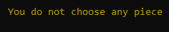
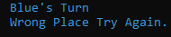

PROGRESS SUMMARY
ADDITIONAL IMPROVEMENT
• Game movements look alive instead of cursors.
• If the user presses wrong the game gives a warning

Slide 11
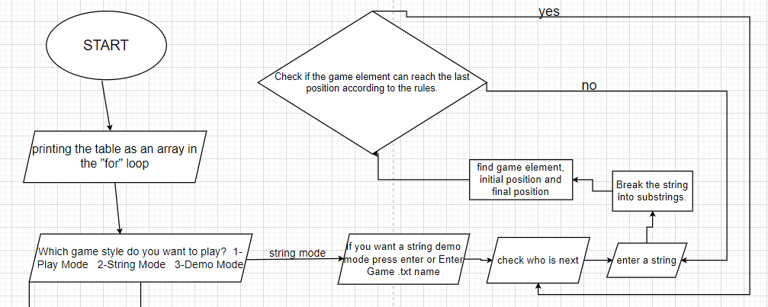
ALGORTHMS AND SOLUTİON STRATAGIES

Slide 12
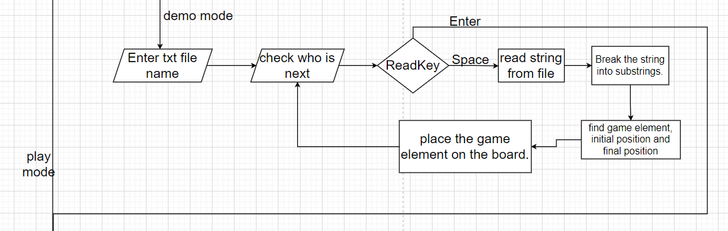
ALGORTHMS AND SOLUTİON STRATAGIES

Slide 13
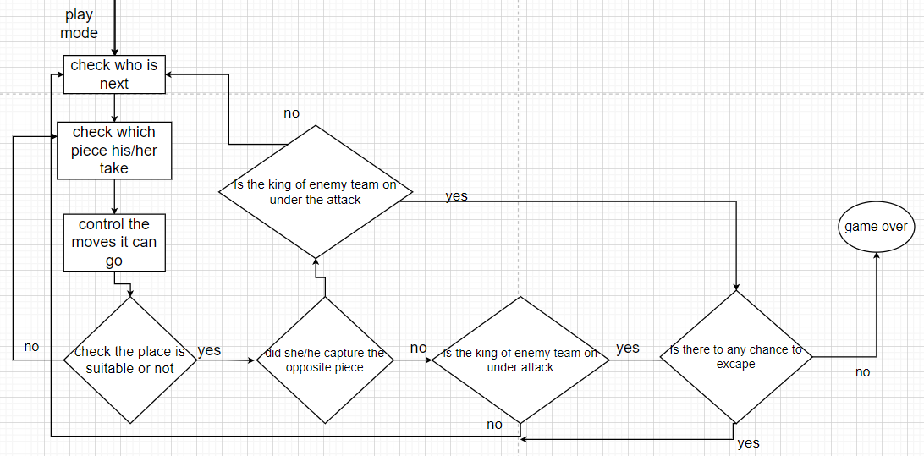
ALGORTHMS AND SOLUTİON STRATAGIES

Slide 14

PROBLEMS ENCOUNTERED
• While doing the string mode, we also had a hard time breaking the string first. Because there were so many combinations.
• More than one value could not be returned in functions. If we need a solution to solve this problem, we created a static variable.

Slide 15
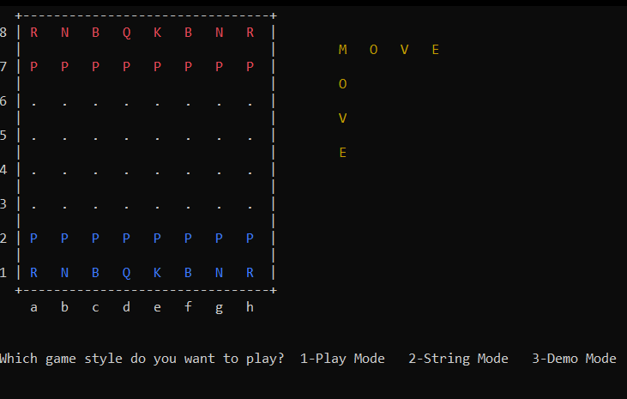
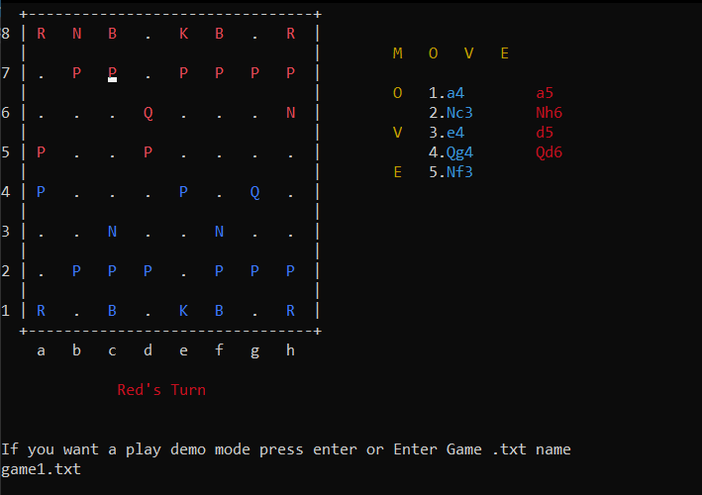
SCREENSHOTS

Slide 16
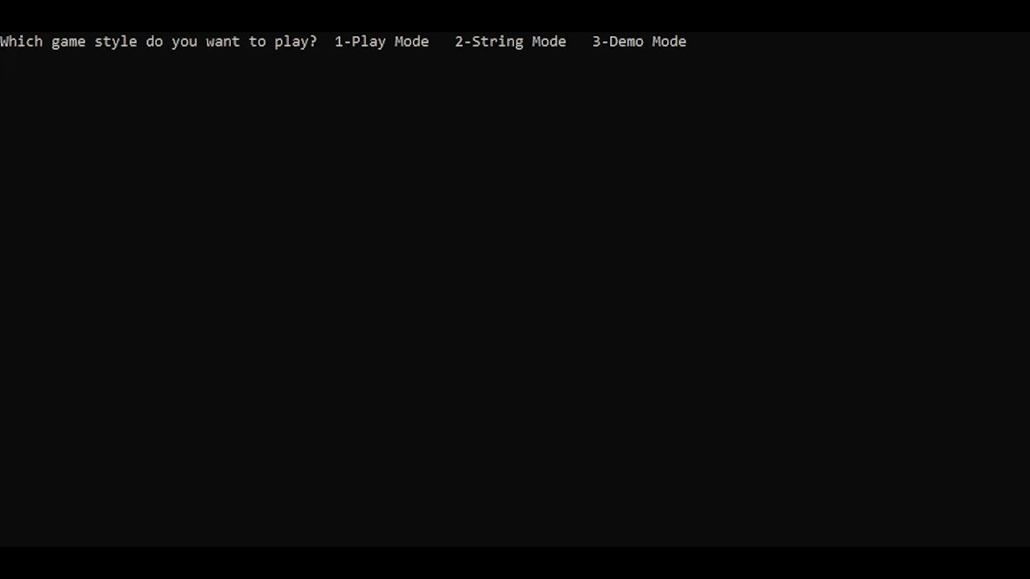
Video( Special Moves)

Slide 17
Video 2(String Mode)

Slide 18
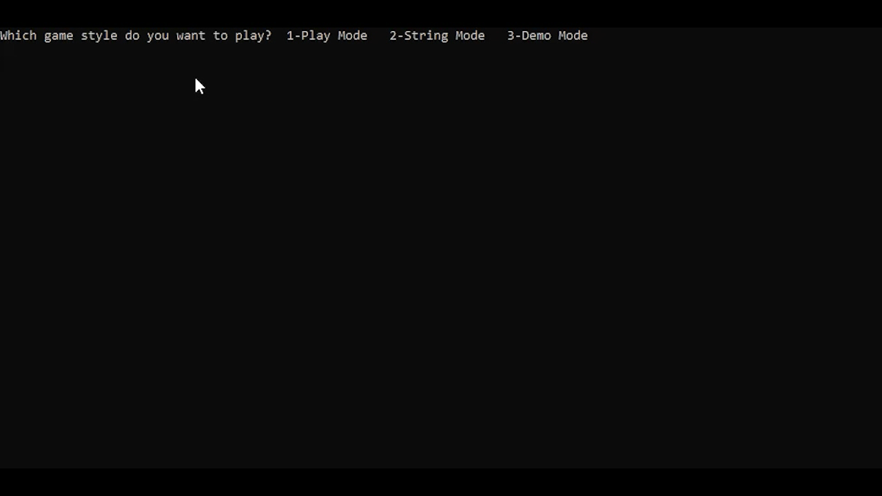
Video 3(Demo Mode)

Slide 19

CONCLUSION
We Have Learned
• Basic principles of C#.
• Making complex algorithms.
• Team work.
• Writing our own functions.
• Thanks to this project, we gained Analytical thinking skills.
• It allowed us to see the relationships between events or situations.
• It helped us think creatively.

Slide 20
REFERENCES
• https://www.geeksforgeeks.org/csharp-programming- language/
• https://www.w3schools.com/cs/cs_intro.asp
• https://www.canva.com
•https://docs.microsoft.com/tr-tr/dotnet/csharp/
• https://stackoverflow.com/

Slide 21
Thank you for listening to us.
Any questions?
DENİZ KÜÇÜKKARA ALİ ŞİYAR ARSLAN FERHAT TEMUR

Slide 22

